Slide 1
Notes of Deep Learning
[1]
Part II (chapter 6-12)
[1] Goodfellow, I., Bengio, Y., & Courville, A. (2016). Deep Learning. The MIT Press.

Slide 2
Part II: Deep Networks: Modern Practices
Chapter 6. Deep Feedforward Networks
Chapter 7. Regularization for Deep Learning
Chapter 8. Optimization for Training Deep Models
Chapter 9. Convolutional Networks
Chapter 10. Sequence Modeling: Recurrent and Recursive Nets
Chapter 11. Practical Methodology
Chapter 12. Applications

Slide 3
Part II: Deep Networks: Modern Practices
Chapter 7. Regularization for Deep Learning

Slide 4
Regularization for Deep Learning
Regularization Definition:
Any modification we make to a learning algorithm that is intended to reduce its generalization error but not its training error.
Some strategies:
Put extra constraints on a machine learning model
Add extra terms in the objective function
Targets:
Encode specific kinds of priori knowledge
Express a generic preference for a simpler model class in order to promote generalization
Effects:
Make an underdetermined problem determined
Other forms of regularization, known as ensemble methods, combine multiple hypotheses that explain the training data

Slide 5
Regularization for Deep Learning
Regularization in context of deep learning:
Most regularization strategies are based on regularizing estimators: works by trading increased bias for reduced variance.
An effective regularizer is one that make a profitable trade, reducing variance significantly while not overly increasing the bias.
Goal:
× Exclude the true data generating process – corresponding to underfitting and inducing bias
√ Matched the true data generating process.
× Included the generating process but also many other possible generating processes – the overfitting regime where variance rather than bias dominates the estimation error.
In practice:
An overly complex model family does not necessarily include the target function or the true data generating process, or even a close approximation of either. Most deep learning algorithms are to domains these.
The best fitting model (in the sense of minimizing generalization error) is usually a large model that has been regularized appropriately.
Regularization

Slide 6
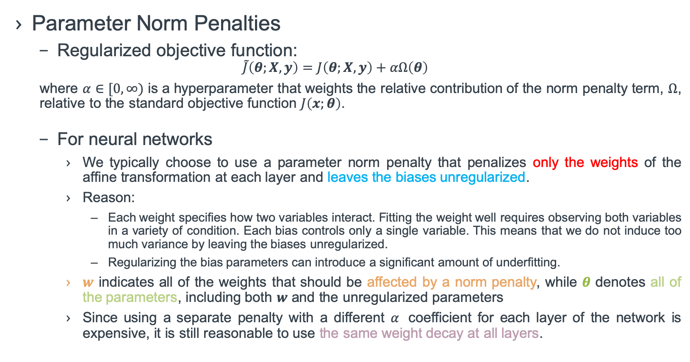
Regularization for Deep Learning
Parameter Norm Penalties
Regularized objective function:
$$\tilde{J}\left(θ;X,y\right)=J\left(θ;X,y\right)+αΩ\left(θ\right)$$
where $α∈[0,∞)$ is a hyperparameter that weights the relative contribution of the norm penalty term, $Ω$, relative to the standard objective function $J\left(x;θ\right)$.
For neural networks
We typically choose to use a parameter norm penalty that penalizes only the weights of the affine transformation at each layer and leaves the biases unregularized.
Reason:
Each weight specifies how two variables interact. Fitting the weight well requires observing both variables in a variety of condition. Each bias controls only a single variable. This means that we do not induce too much variance by leaving the biases unregularized.
Regularizing the bias parameters can introduce a significant amount of underfitting.
$w$ indicates all of the weights that should be affected by a norm penalty, while $θ$ denotes all of the parameters, including both $w$ and the unregularized parameters
Since using a separate penalty with a different $α$ coefficient for each layer of the network is expensive, it is still reasonable to use the same weight decay at all layers.

Slide 7
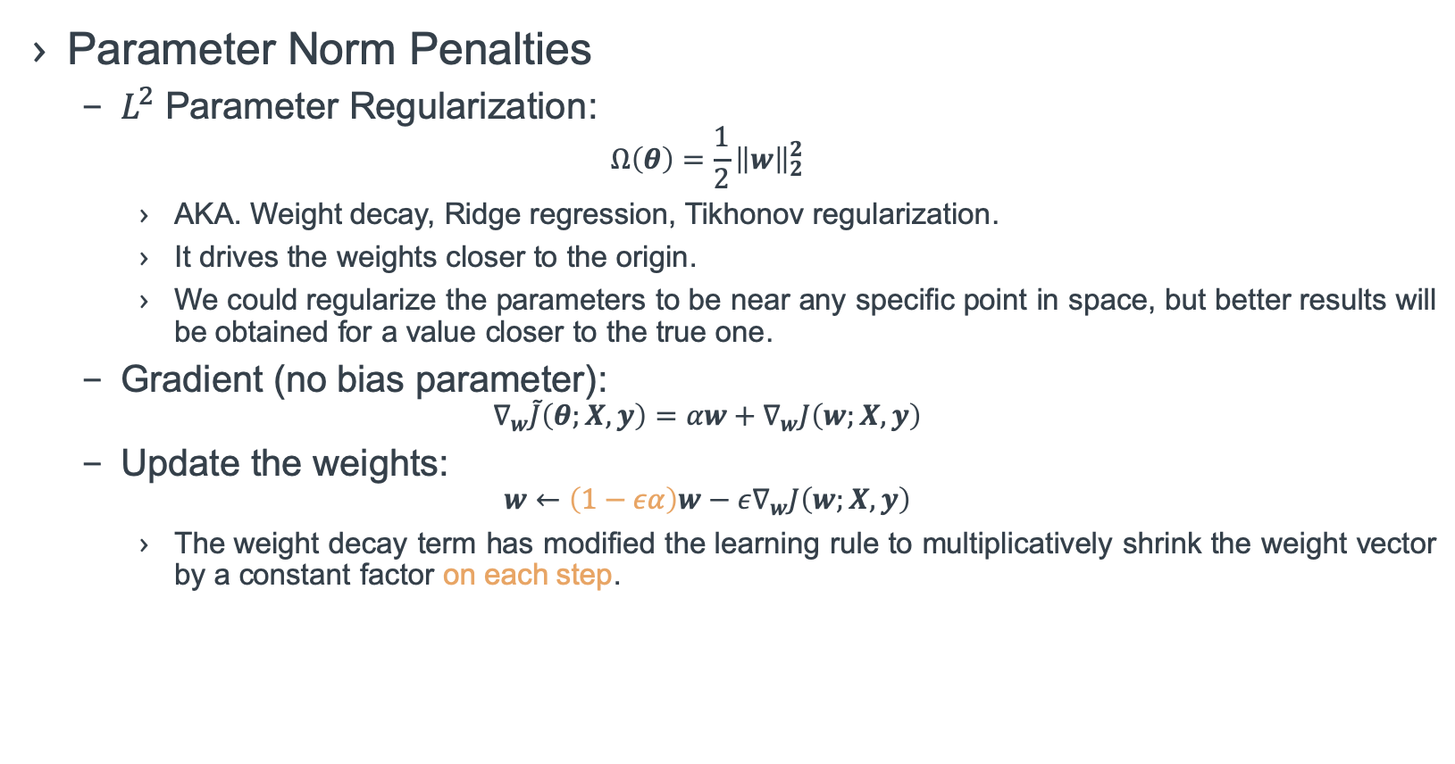
Regularization for Deep Learning
Parameter Norm Penalties
$L^{2}$ Parameter Regularization:
$$Ω\left(θ\right)=\frac{1}{2}{\left\|w\right\|}_{2}^{2}$$
AKA. Weight decay, Ridge regression, Tikhonov regularization.
It drives the weights closer to the origin.
We could regularize the parameters to be near any specific point in space, but better results will be obtained for a value closer to the true one.
Gradient (no bias parameter):
$$∇_{w}\tilde{J}\left(θ;X,y\right)=αw+∇_{w}J\left(w;X,y\right)$$
Update the weights:
$$w←\left(1−εα\right)w−ε∇_{w}J\left(w;X,y\right)$$
The weight decay term has modified the learning rule to multiplicatively shrink the weight vector by a constant factor on each step.

Slide 8
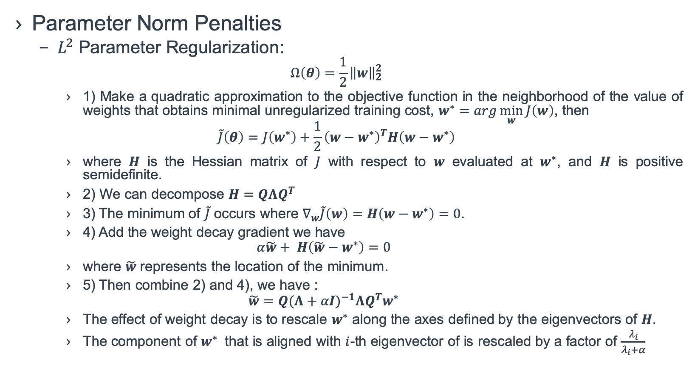
Regularization for Deep Learning
Parameter Norm Penalties
$L^{2}$ Parameter Regularization:
$$Ω\left(θ\right)=\frac{1}{2}{\left\|w\right\|}_{2}^{2}$$
1) Make a quadratic approximation to the objective function in the neighborhood of the value of weights that obtains minimal unregularized training cost, $w^{∗}=arg\min_{w}{J\left(w\right)}$, then
$$\tilde{J}\left(θ\right)=J\left(w^{∗}\right)+\frac{1}{2}{\left(w−w^{∗}\right)}^{T}H\left(w−w^{∗}\right)$$
where $H$ is the Hessian matrix of $J$ with respect to $w$ evaluated at $w^{∗}$, and $H$ is positive semidefinite.
2) We can decompose $H=QΛQ^{T}$
3) The minimum of $\tilde{J}$ occurs where $∇_{w}\tilde{J}\left(w\right)=H\left(w−w^{∗}\right)=0$.
4) Add the weight decay gradient we have
$$α\tilde{w}+ H\left(\tilde{w}−w^{∗}\right)=0$$
where $\tilde{w}$ represents the location of the minimum.
5) Then combine 2) and 4), we have :
$$\tilde{w}=Q{(Λ+αI)}^{−1}ΛQ^{T}w^{∗}$$
The effect of weight decay is to rescale $w^{∗}$ along the axes defined by the eigenvectors of $H$.
The component of $w^{∗}$ that is aligned with $i$-th eigenvector of is rescaled by a factor of $\frac{λ_{i}}{λ_{i}+α}$

Slide 9
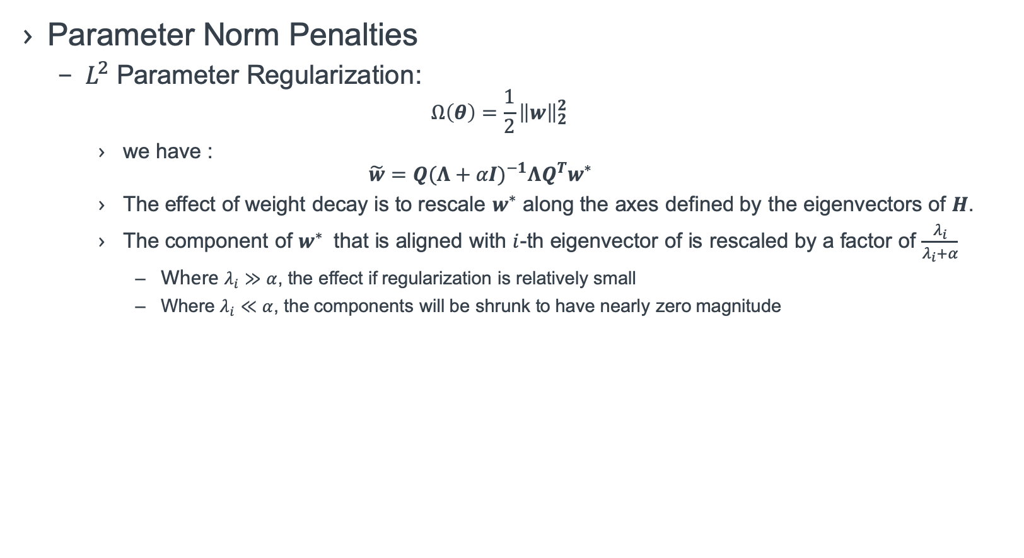
Regularization for Deep Learning
Parameter Norm Penalties
$L^{2}$ Parameter Regularization:
$$Ω\left(θ\right)=\frac{1}{2}{\left\|w\right\|}_{2}^{2}$$
we have :
$$\tilde{w}=Q{(Λ+αI)}^{−1}ΛQ^{T}w^{∗}$$
The effect of weight decay is to rescale $w^{∗}$ along the axes defined by the eigenvectors of $H$.
The component of $w^{∗}$ that is aligned with $i$-th eigenvector of is rescaled by a factor of $\frac{λ_{i}}{λ_{i}+α}$
Where $λ_{i}≫α$, the effect if regularization is relatively small
Where $λ_{i}≪α$, the components will be shrunk to have nearly zero magnitude

Slide 10
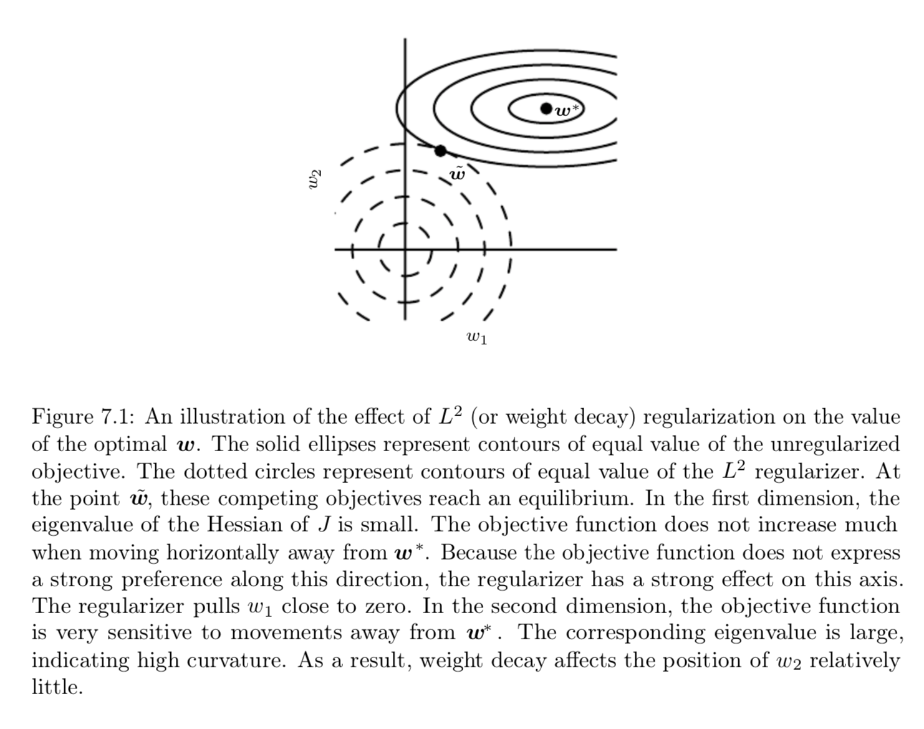

Regularization for Deep Learning
Parameter Norm Penalties
$L^{2}$ Parameter Regularization:

Slide 11
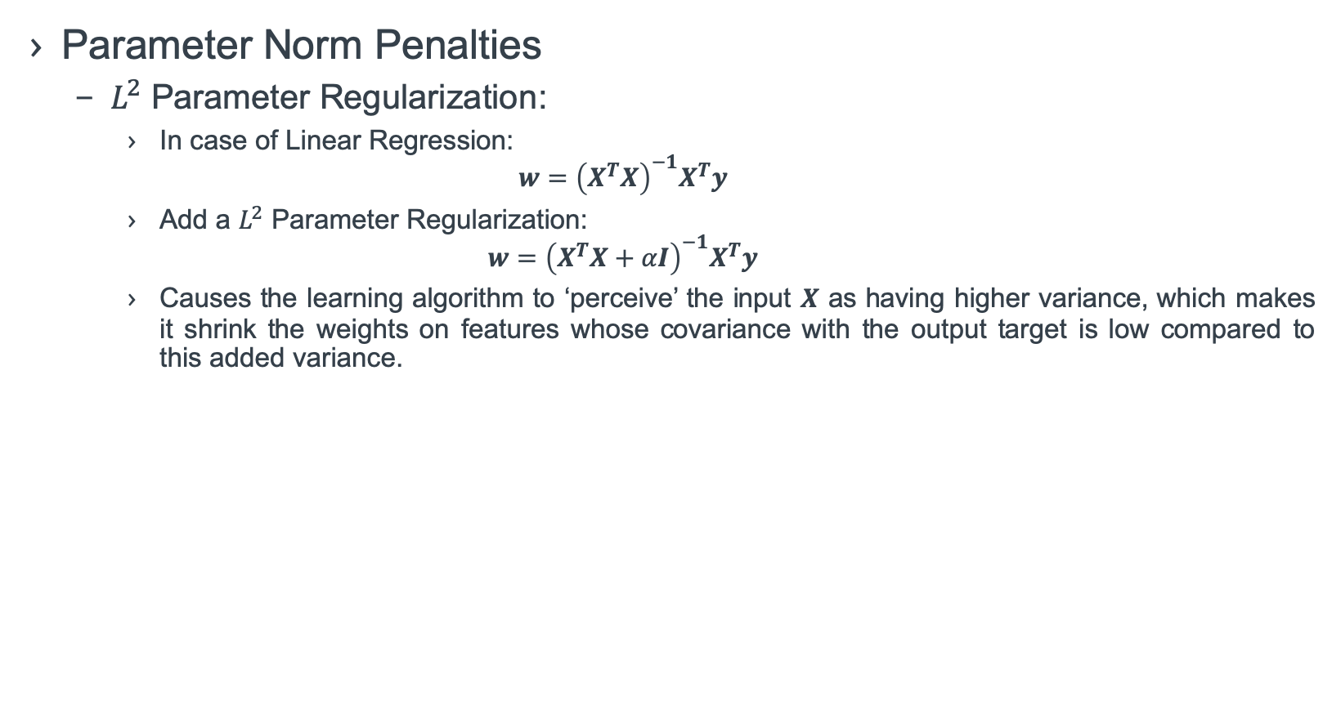
Regularization for Deep Learning
Parameter Norm Penalties
$L^{2}$ Parameter Regularization:
In case of Linear Regression:
$$w={\left(X^{T}X\right)}^{−1}X^{T}y$$
Add a $L^{2}$ Parameter Regularization:
$$w={\left(X^{T}X+αI\right)}^{−1}X^{T}y$$
Causes the learning algorithm to ‘perceive’ the input $X$ as having higher variance, which makes it shrink the weights on features whose covariance with the output target is low compared to this added variance.

Slide 12
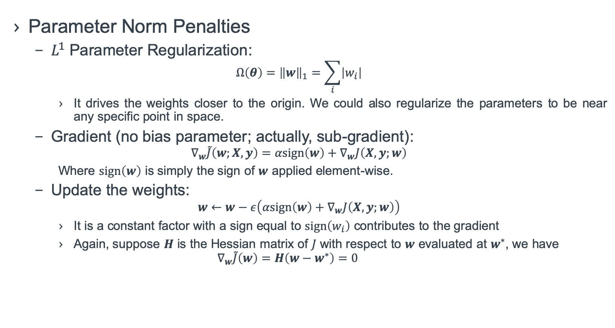
Regularization for Deep Learning
Parameter Norm Penalties
$L^{1}$ Parameter Regularization:
$$Ω\left(θ\right)={\left\|w\right\|}_{1}=\sum_{i}{\left|w_{i}\right|}$$
It drives the weights closer to the origin. We could also regularize the parameters to be near any specific point in space.
Gradient (no bias parameter; actually, sub-gradient):
$$∇_{w}\tilde{J}\left(w;X,y\right)=αsign\left(w\right)+∇_{w}J\left(X,y;w\right)$$
Where $sign\left(w\right)$ is simply the sign of $w$ applied element-wise.
Update the weights:
$$w←w−ε\left(αsign\left(w\right)+∇_{w}J\left(X,y;w\right)\right)$$
It is a constant factor with a sign equal to $sign\left(w_{i}\right)$ contributes to the gradient
Again, suppose $H$ is the Hessian matrix of $J$ with respect to $w$ evaluated at $w^{∗}$, we have
$$∇_{w}\tilde{J}\left(w\right)=H\left(w−w^{∗}\right)=0$$

Slide 13
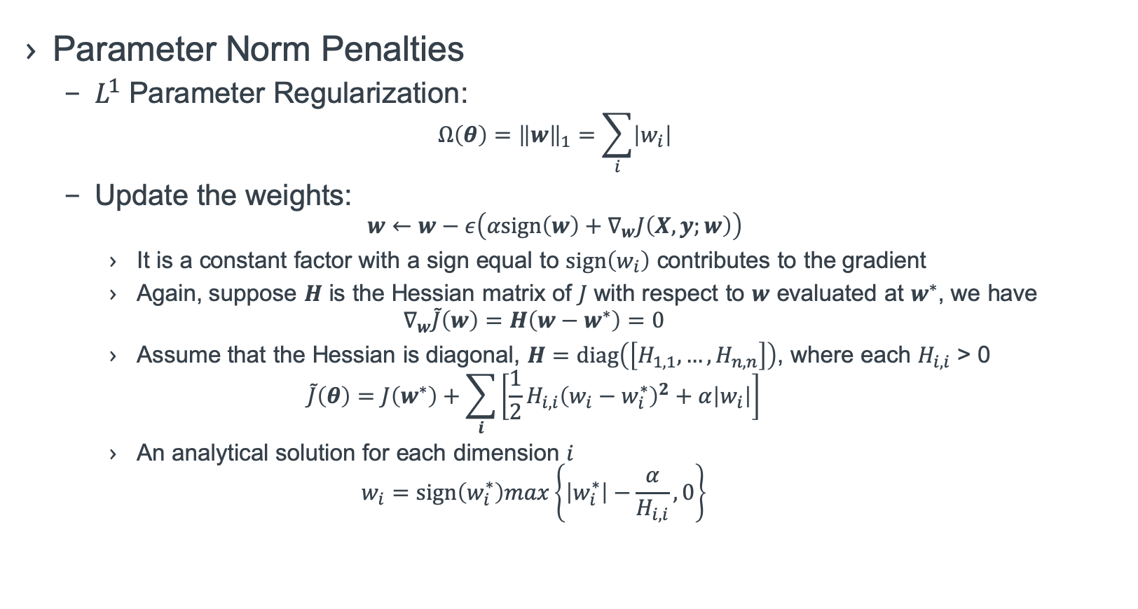
Regularization for Deep Learning
Parameter Norm Penalties
$L^{1}$ Parameter Regularization:
$$Ω\left(θ\right)={\left\|w\right\|}_{1}=\sum_{i}{\left|w_{i}\right|}$$
Update the weights:
$$w←w−ε\left(αsign\left(w\right)+∇_{w}J\left(X,y;w\right)\right)$$
It is a constant factor with a sign equal to $sign\left(w_{i}\right)$ contributes to the gradient
Again, suppose $H$ is the Hessian matrix of $J$ with respect to $w$ evaluated at $w^{∗}$, we have
$$∇_{w}\tilde{J}\left(w\right)=H\left(w−w^{∗}\right)=0$$
Assume that the Hessian is diagonal, $H=diag\left(\left[H_{1,1},…,H_{n,n}\right]\right)$, where each $H_{i, i}$ > 0
$$\tilde{J}\left(θ\right)=J\left(w^{∗}\right)+\sum_{i}{\left[\frac{1}{2}H_{i, i}{\left(w_{i}−w_{i}^{∗}\right)}^{2}+α\left|w_{i}\right|\right]}$$
An analytical solution for each dimension $i$
$$w_{i}=sign\left(w_{i}^{∗}\right)max\left\{\left|w_{i}^{∗}\right|−\frac{α}{H_{i,i}},0\right\}$$

Slide 14
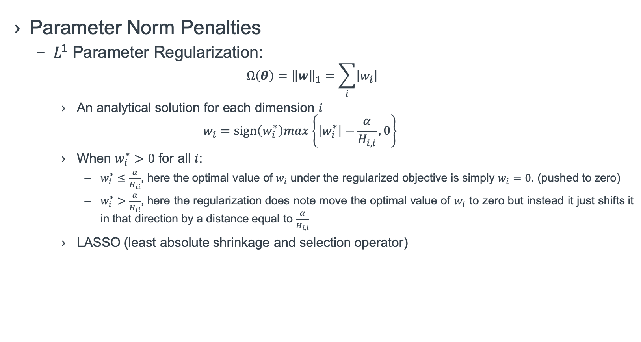
Regularization for Deep Learning
Parameter Norm Penalties
$L^{1}$ Parameter Regularization:
$$Ω\left(θ\right)={\left\|w\right\|}_{1}=\sum_{i}{\left|w_{i}\right|}$$
An analytical solution for each dimension $i$
$$w_{i}=sign\left(w_{i}^{∗}\right)max\left\{\left|w_{i}^{∗}\right|−\frac{α}{H_{i,i}},0\right\}$$
When $w_{i}^{∗}>0$ for all $i$:
$w_{i}^{∗}≤\frac{α}{H_{ii}}$, here the optimal value of $w_{i}$ under the regularized objective is simply $w_{i}=0$. (pushed to zero)
$w_{i}^{∗}>\frac{α}{H_{ii}}$, here the regularization does note move the optimal value of $w_{i}$ to zero but instead it just shifts it in that direction by a distance equal to $\frac{α}{H_{i,i}}$
LASSO (least absolute shrinkage and selection operator)

Slide 15

Regularization for Deep Learning
Parameter Norm Penalties
MAP Bayesian inference with $L^{2}$ regularization is equivalent to MAP Bayesian inference with a Gaussian prior on the weights. (Sec. 5.6.1)
MAP Bayesian inference with $L^{1}$ regularization is equivalent to the log-prior term that is maximized by MAP Bayesian inference when the prior is an isotropic Laplace distribution over $w$. (Eq. 3.26)

Slide 16
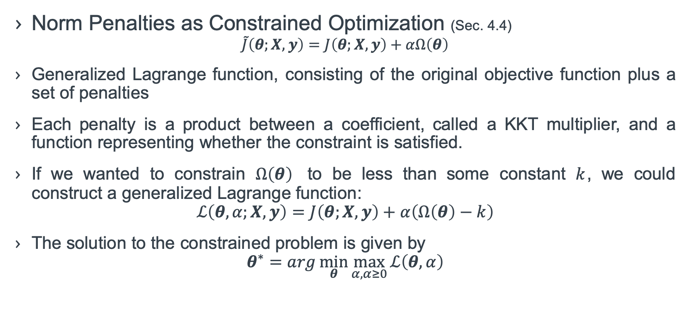
Regularization for Deep Learning
Norm Penalties as Constrained Optimization (Sec. 4.4)
$$\tilde{J}\left(θ;X,y\right)=J\left(θ;X,y\right)+αΩ\left(θ\right)$$
Generalized Lagrange function, consisting of the original objective function plus a set of penalties
Each penalty is a product between a coefficient, called a KKT multiplier, and a function representing whether the constraint is satisfied.
If we wanted to constrain $Ω\left(θ\right)$ to be less than some constant $k$, we could construct a generalized Lagrange function:
$$ℒ\left(θ,α;X,y\right)=J\left(θ;X,y\right)+α\left(Ω\left(θ\right)−k\right)$$
The solution to the constrained problem is given by
$$θ^{∗}=arg\min_{θ}{\max_{α,α≥0}{ℒ\left(θ,α\right)}}$$

Slide 17
To be continued

